Slide 1
Agility, Efficiency and Innovation Through
Continuous Application Management
Develop, deploy and manage tomorrow’s applications…today
Notes:
Introduction

Slide 2


Presenters
Shahar Erez, Director, Application Management Products at VMWare
Shahar Erez is responsible for setting the product and go-to-market strategies for VMware’s Application Management products. Shahar has more than 12 years of product development, management and strategy experience. Before joining VMware, Erez served as the Director of products for BTO Analytics at HP he led and incubated the design and release of HP Service Health Analyzer, a new solution to automate complex IT performance analysis issues. Prior to joining HP he spent four years managing product launches at Mercury Interactive before the company was acquired by HP in 2006. Erez earned his MBA from Technion (the Israel Institute of Technology) and his bachelor of science degree in computer science from the Interdisciplinary Center in Hertzeliya, Israel
Komal Mangtani, Director Engineering Application Management Products at VMWare
Komal Mangtani is Engineering Director at VMware leading its Application Lifecycle Management strategy. She has been with VMware for 5 years. While at VMware, she conceptualized and led development for vFabric Application Director and VMware Studio products. Prior to VMware, she has held technical and management positions at Oracle and BEA Weblogic Systems working on industry standard application stacks – BEA Weblogic Server and Oracle Database, Oracle Enterprise Manager. With strong applications background and spending early days at VMware working with ESX/vSphere, she brings together application and virtualization technologies to create unique value proposition for the products.

Slide 3




Business in the Fast Lane
Time to 50,000,000 users:
Radio
38 years
Television
13 years
Internet
4 years
Facebook
1,096 days
Google+
88 days
Did not exist 10 years ago, and today have millions of subscribers and offer high-quality services at no-charge
Innovation, efficiency and agility are requirements for survival
Notes:
Its seems that the pace of change we are experiencing in the last several years, while mind blowing will only accelerate.
Looking back at the history of innovation and the time it took for the consumer of that innovation to adopt and adapt to the change innovation has brought.
In fact if you look up until the middle of previous century people experienced a handful new innovation throughout a persons life, adults that experienced the inception of the Radio, probably didn’t get to see a TV for many more years.
Today, change is dominant, from facebook to Google+ to the mind-blowing Instgram story, it actually seems that the next big thing is available before todays innovation is realized, it is very likely that the next big thing has already happened, but you have not been invited to it yet.
So to survive in this environment organization must keep, or actually accelerate innovation, adopt an agile approach that removes any barriers to innovation not just to grow, but even for just staying in business.
So if innovation is key to survival, where is the source of innovation to drive success
Increased pace of change
Shorter Business Cycles and Competitive Advantages
Emergence of new mediums, business models, companies and industries
Competition with products and services delivered at ‘No-Charge’

Slide 4


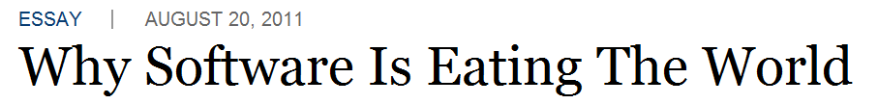

Applications Make the World Go Round
Notes:
The first primary of this transition is the technology that enables innovation, and when we speak of technology, its primarily software.
You may have seen a piece in the Wall Street Journal by Marc Andreessen entitled “Why Software is Eating the World”.
Marc, probably one of the greatest innovators of the past few decades, who invented the first browsers, the first “Cloud” and has mad some of the strategic start investments over the past 5 years, makes the point that every company today is in the software business and software is the centerpiece of competitive dynamics in industries as diverse as automobiles, retailing, logistics, media and entertainment, telecommunications, energy, agriculture and financial services.
The software we’re talking about here are applications that drive your business – that take orders, move packages, render movies, stream music, find oil, etc. The economy is littered with examples of how one company used an application to take business away from their competitors: Amazon killed Borders through an application that allows them to deliver digital books, WalMart killed their competitors b/c of their ability to optimize supply chain and pricing in a way that nobody could match. Oil companies compete on their ability to build applications that allow them to find wells before their competitors. Cars are increasingly run by custom applications.
As the world has become increasingly connected, there is no business that is immune and which is why there is a business imperative of figuring out how to build applications faster and better than your competitors.
.
So if every company is a software company, and IT organizations are the ones tasked with delivering this innovative software, do these IT organizations realize the magnitude of the business they are tasked with?

Slide 5

The Reality Check
IT does not enable the business, it is the business
Global executives believe innovation is extremely important to their growth strategies
Are unsatisfied with their innovation performance
84%
94%
“…CMOs will spend more on IT than CIOs”
http://http://www.forbes.com/sites/lisaarthur/2012/02/08/five-years-from-now-cmos-will-spend-more-on-it-than-cios-do//
Notes:
In fact they do, most executives surveyed showed significant concerns when it comes to innovation.
They do understand the growth and survival of their businesses depends on their ability to innovate, however, almost all of them testified they are not happy with how things are going.
They are spending over 70% of their resources on maintaining the business and are hardly able to bring any innovation to fruition in reasonable time.
Hence their business as IT vendors is at risk, but they are also putting their consumers at business risk as well.
You might have caught this piece just 3 weeks ago on Forbes, this is a Gartner quote” By 2017. CMOs will be spending on IT more than CIOs, quite an overwhelming, actually scary thought, it means that the business realized that technology is where it can differentiate and where it can drive the business, however, they doubt their own IT is the partner to go out with..
Why is that? Well I guess the business sees reality, IT in most organizations as not tunes it self to the new challenges.
Lets take a look at an IT dynamics

Slide 6
Business Places Strict Demands of IT – Is IT Ready?
Innovation
Risk
Capex vs.
Opex
Innovation
CIO
Efficiency
Agility
Efficiency
Agility
Development
Operations
Speed
Stability
QoS
Notes:
The dynamics in most IT organizations is a follows, the development organizations are often focused around one things, achieving development agility – Develop fast, explore new technologies, move fast and work on the “cool” stuff, hence accelerating change at any cost
The operations team on the other hand are focused on maintaining efficiency - maintaining system, stability and assuring QoS for the current services the business offers.
The CIO, which we just mentioned is worried about the innovation his organization is unable to deliver, but is worried about accelerating change while maintaining expenses and reducing risk – Security, compliancy etc…
As a result of the three dispersed vectors, the business is actually loosing on all three fronts Innovation reduced, and so is the operational efficiency and Agility
So now, the development organizations as they realize they cannot innovate in the required pace and the Operations team cannot support them on the innovation quest are pushing IT towards a new horizon – PaaS – PaaS will solve all the innovation problems for IT.

Slide 7

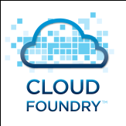
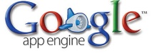
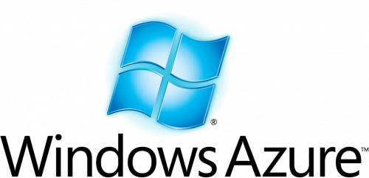

Is PaaS the holy grail?
Platform-as-a-Service
Agility
Simplicity
Enable innovation
Vendor Lock-In
Immature
Not enterprise-ready
Today, less than 5% of business Applications run on PaaS
PaaS is a journey…
…you need an actionable path TODAY to enable
innovation in the face of constant change.
Notes:
Is PaaS indeed a holy grail?
Lets examine that assumption.
PaaS does provide agility – No need to deal with the underlying infrastructure, it is very simple, if you are a developer you can just go and code and hence, innovation becomes so much simpler. Your developers can now focus almost twice as much on pure coding, and are no longer dependent on the operations team ability to support them.
But and it’s a big but, PaaS today still creates a vendor lock in, deciding to go with one platform, pretty much means you will need to invest tremendously if you ever leave, talk about a hotel California. PaaS is still immature and still lacks core enterprise needs for Security, technology varieties, resiliency and integration.
A Pretty hefty risk to take if you want to bet your enterprise business on it today, and as a result the reality is that less than 5% of todays business Apps run on PaaS and the majority are try outs / hello world PaaS. So not many CIOs are ready to bet their farm on this brand new approach
Now, we need to be cautious as we talk of PaaS, there are really several different types of PaaS out there. – Facebook and google’s Apps are single App / Technology PaaS
Sales Force and Intuit are more integration PaaS, if you want to integrate with their services and there, Applications are built for the business from the get go. But the pure PaaS Apps – Heroku, Azure and even Cloud Foundry are still mostly developer and small team plays not enterprise ones.
So PaaS is a journey, it will quickly evolves, but not something to bet your company’s future on just yet.
What are these Apps and services that business is in such dire need to innovate

Slide 8


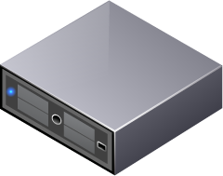


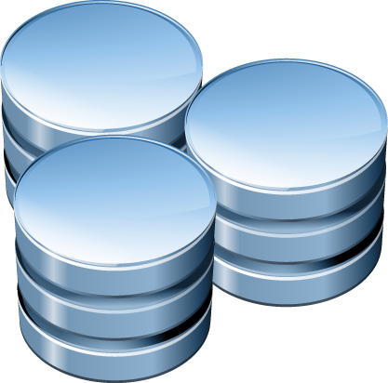

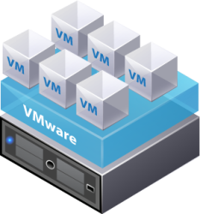


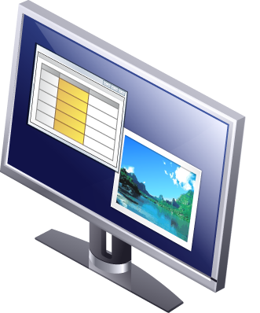



Application evolution
Yesterday
Waterfall development
Weeks to provision
Static resources
Limited change windows
$100k+ of compute
Limited number of users, in business hours
App Server
Web Server
Database
End Users
Internet/Firewall
Lan/network
Web front-end
Services
Middleware
Tomorrow
Agile development
Continuous deployment
Dynamic resourcing
Spans across data centers and clouds
Friction of compute costs
Millions of users with 24x7 access
In Memory Cache
Web Server
App Server
App Server
Public
Database
Message Q
Private
Public
Notes:
There is a significant change in how these applications, the business is relying on, are delivered
Looking at yesterday's Apps these Applications were a result of a waterfall process where development cycle took 6-9 months and the applications developed in low level development languages, although a mere straight forward three tier apps, took weeks to actually set up until they were operationally ready, these applications were places on static resources which were which costs hundreds of thousands of compute resources and server a limited number of users in specified business hours. These Apps had a very defined change window months / weeks at best because change meant – Downtime.
Tomorrow’s up are actually radically different,
These apps are built on dynamic flexible resources they may scale up or down in or out, they will use external services like PayPal, Redis, or other services and they will move from one resource pool to another, it will cost a friction of the compute cost to run them and although far more complex and although they serve many more users 24*7, but although these Apps are far more complex and much more service oriented, will need to support the business needs and apply changes on a daily basis and accommodate the new agile development paradigms.
So, innovation is a need, Applications are becoming more complex and the ability to adopt agility needs to be resolved, so what is the next step?

Slide 9

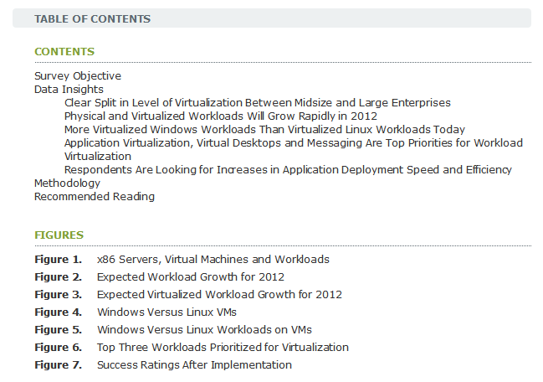
How to get there – Cloud is driving innovation
User Survey Analysis: Physical and Virtualized Workloads to Grow Rapidly Worldwide in 2012
14 February 2012
“Respondents are satisfied that virtualization is reducing data center floor space, energy cost and thermal output. However, expectations for an overall reduction in hardware capital expenditure and increased application deployment speed and efficiency have not been fully met”
Cloud is accelerating innovation—The number of Applications moving to IaaS is more than doubling each year.
Notes:
Well, one way and probably the most common way to set course to increased innovation and agility is to adopt a new approach, this approach starts with Cloud Infrastructure, IaaS adoption is widely getting adopted today both by small startups and large enterprises, Cloud Infrastructure comes in different forms, on premise private clouds as well as public “hosted service” types of clouds.
The clouds, driven by the growth in the virtualization technologies has already proven to bring significant reduction in cost, but has still not brought the promised agility, although the growth in Applications moving to the cloud is quite significant and estimates are these clouds will run 50% of the worlds applications in 5 years!
How does IaaS really enable operationalizing innovation, it is primarily driven by the cloud operating model.

Slide 10
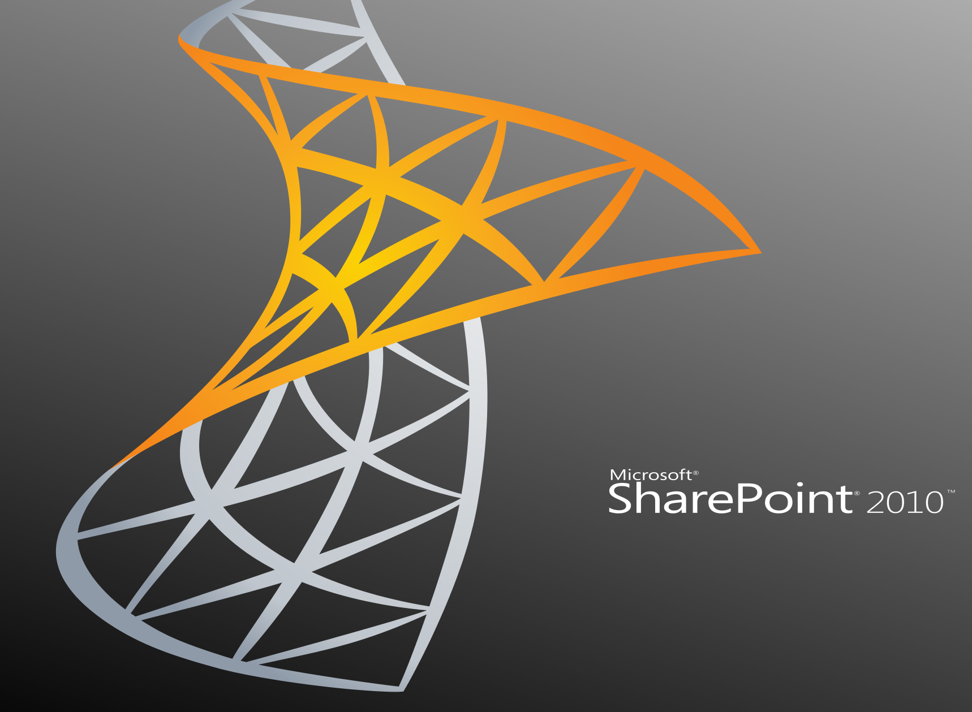









The “Cloud operating model” enabling efficiency and agility
App Ops
App release, Performance,
Availability, Usage, Cost,
Infrastructure Service Health and Cost
Utilization and App Visibility
Cloud Ops
(Infra Ops)
Infrastructure Performance, Capacity, Config, Security
NW
NW
Storage
Storage
Compute
Compute
Private
Public
Notes:
As applications get virtualized and pushed into a cloud (Private or public) there is a very clear separation between the infrastructure management paradigm and the application management one – they are no more intertwined.
There are two distinct functions with clear goals and fields of expertise
The infrastructure managers are provider of compute platform for the VMs running on them and should not care what is in that VM, their goals is to endure, there is commoditized infrastructure that is always available, it is well performing, secured and well configured and will always have excess capacity to satisfy needs
The Application owners do not care where physically or on which HW their applications are running
There is however the need to provide visibility to both sides of the wall as to what is happening on the other side: Application owners need to know the platform is indeed providing adequately to the demand of the application (Compute power, I/O, disk latency etc..) in a clear aggregated matter.
The Infrastructure owner will need to know the Application is running well if they conduct change to the platform

Slide 11
Dev Ops
DevOps is a response to the interdependence of
software development and IT operations.
Result of organizations that could not tolerate the
ramifications of two camps with different MBOs
Production
Handoff
Package
Test
Deploy
Stage
Package
Build
Code
Design
Requirements
Development
Operations
DevOps

Slide 12
Aligned IT
Development
Delivering Innovation
Innovation
Change
Agility
CIO
Enabling Innovation
Risk
Capex vs. Opex
Innovation
Operations
Managing Innovation
Stability
QoA
Efficiency

Slide 13








Traditional Deployment & Configuration Tools Break in the Cloud
Complex and time consuming
  Bottom up thinking
  Vertical and static approach
  On going management is procedural and reactive
Proliferation of IT assets
  Lack of standardization increases permutations of software components
Not cloud aware
  Each deployment plan is tied to a specific infrastructure service
OS
Configure
MW
App
App
OS
OS
OS
Deploy MW
OS
Configure OS
Deploy OS
Deploy OS
Deploy MW
Configure OS

Slide 14


vFabric Application Management – New approach
IT Developers
“Write code, not tickets”
IT Operations
“IT as a service provider”
Boost application velocity
Friction-free deployment
  Latest high productivity frameworks
Choice of application services
Cloud portability
More responsive to developers
Elastic and dynamically scalable
Change aware
Digest future cloud advances
Cloud portability

Slide 15
Let’s take VMware Engineering Team’s perspective
Notes:
Need to ensure smooth transition

Slide 16




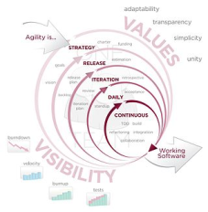





A fresh look at today’s Application Landscape
Written in diverse frameworks and languages
Traditional (Java, .Net) and Modern Frameworks
Developed with ‘agile’ or ‘iterative’ methodologies
Apps released early and often
Deployed on virtual and cloud infrastructure
Span across Private, Public and Hybrid Clouds
Public/Private/Hybrid Cloud
Private Clouds
Public Clouds
Source: http://en.wikipedia.org/wiki/Agile_software_development
Notes:
Few years back, when we started looking at how to EFFECTIVELY manage workloads that run within Vmware VM’s and on ANY virtualization platforms, we took a fresh look at the EMERGING application landscape. The key trends we notice are :
1. Applications are being written in variety of languages using variety of frameworks. Gone are the days when apps were written in C/C++ or Java. Now we have JEE, Spring, .Net but we also have RoR, Jango, NodeJS, Scala. On the database end, we have alongwith SQL databases, the emerging use of NOSQL database : Cassandra, MongoDB, CouchDB. Then there is the upcoming arena of BiGDATA that brings in apps based on Hadoop/Hbase/HDFS .
2. The second key trend we notice is about HOW the apps are developed. As Shahar mentioned, We used to have waterfall model where it took almost 2 years to deliver on a concept or an idea. Now we have Agile/SCRUM development methodologies that enables iterative dev/test/release cycles. The result of which is apps are released early and often. This gave rise to the DevOps model, that Shahar described, that makes us wonder whether development and operations are two different job functions after all.
3. So far we looked at how the applications are DEVELOPED. Taking a quick glance at how the applications are DEPLOYED, we see – applications are no more tied to a particular infrastructure. With the emergence of private and public cloud, there is no guarantee where an app will reside. It may be on EC2 for dev/test and on private vCloud for production deployment.

Slide 17
Enabling the lifecycle for any app, anywhere
ANY type of app
Hybrid Clouds
Enabling the lifecycle
Private
Provision
Public
Secure
Custom IaaS
Monitor
PaaS
Update
Custom PaaS
Notes:
Looking at these trends, we decided to base our strategy on 3 key axis :
We HAVE to enable Applications written in any language using variety of frameworks and databases
We HAVE to enable Apps on any kind of infrastructure
We HAVE to enable entire lifecyle of an app : provision an app, keep it compliant based on various cloud policies, ongoing monitoring of app performance and allowing various maintenance activities on the app.
Drilling into the 3rd axis in some details,

Slide 18
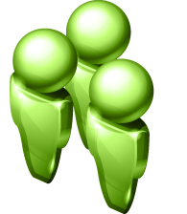

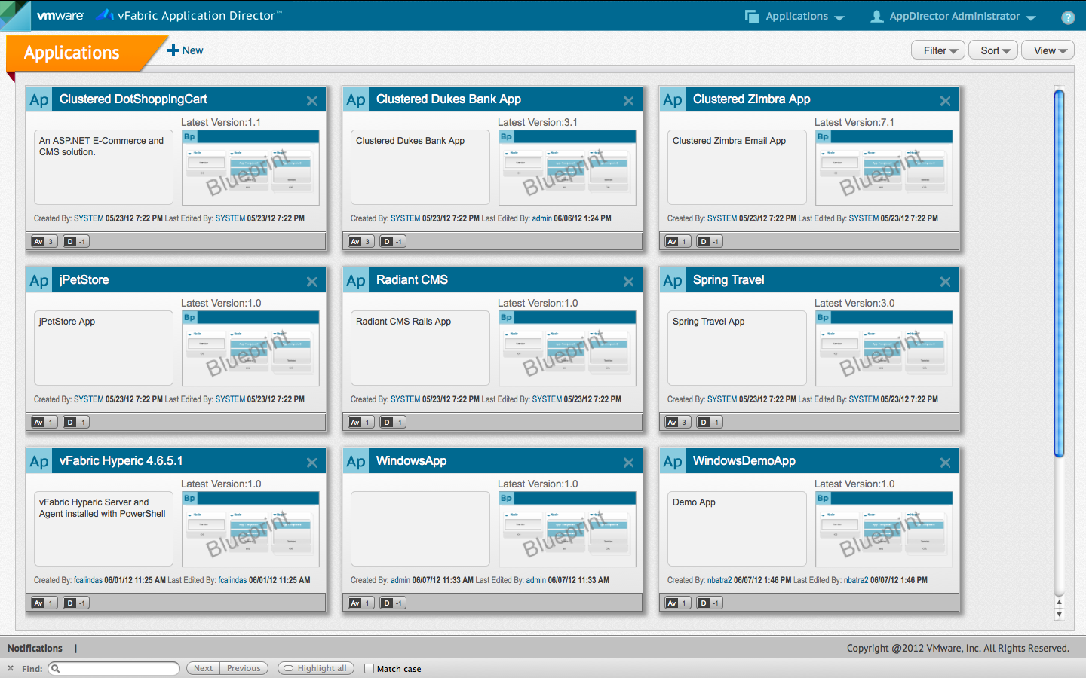
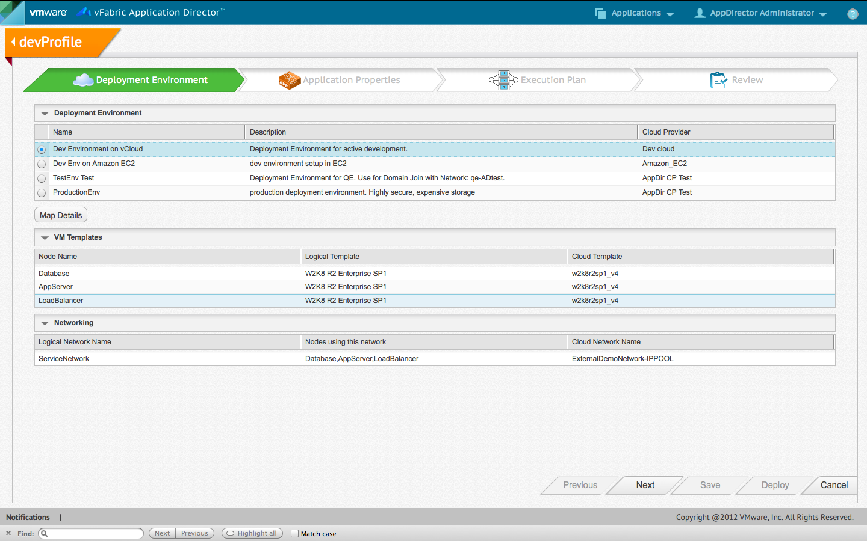

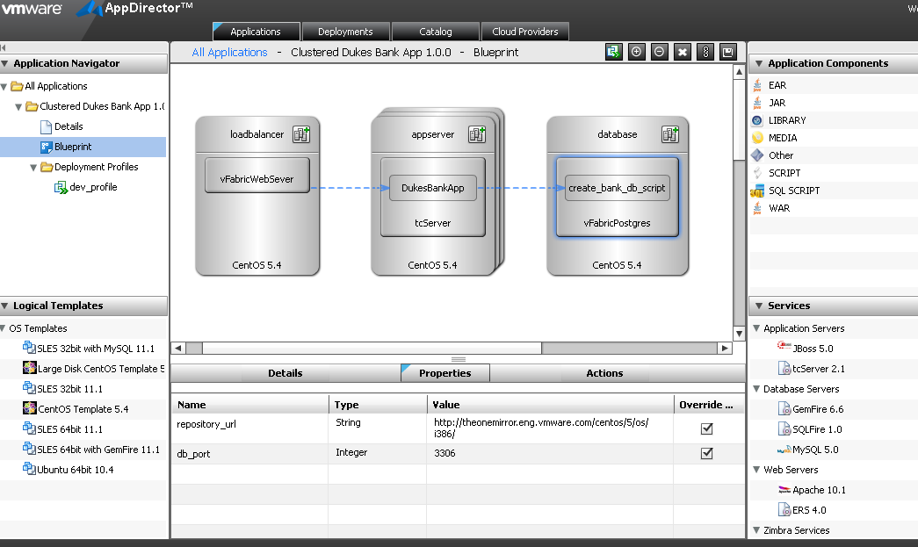
Impact of Cloud and DevOps, on the Provisioning Process
Traditional app provisioning
Setup Infrastructure
Deploy and configure application middleware
Configure N/w and Storage
Setup Application Middleware
Deploy
Application
Development
Different Clouds
Production
Test
Deploy and Configure OS
Connect it to Database
4 days to
8 weeks
What app provisioning should be …
An application architect uses a self-serve application provisioning portal to fully provision & update applications across any registered cloud
Minutes
Notes:
Looking at these trends, we started wondering – how will this application landscape transform the traditional provisioning process.
Refering to Shahar’s point on Traditional App Provisioning was about - obtaining compute resources, configuring network, storage , deploying OS . Next is deploying application stack bottom up – deploy appservers, connect to an existing database, so forth. Finally deploying the actual app.
In the cloud era and more importantly to enable the devOps model, you need a top-down approach – define the application constructs, their configurations and then bind them to a specific IaaS platform.

Slide 19
Impact of Cloud and DevOps, on Monitoring and Maintenance Process
Traditional app monitoring/updates
Deploy
Monitor
Update
Trouble shoot
Guess?
Time
Accuracy
War room
Fix
False start
What app monitoring/updates should be…
Optimize
Change
Build
Deploy
Monitor
Time
Accuracy
Continuous, factual data about application performance
Notes:
Next we took a look at the monitoring and maintenance process. In traditional world, once you see a drop in performance and guessing game begins. With some amount of troubleshooting information gathered, war room meetings between mw admin, infrastructure admin and apps team are held. Assumptions are made without enough information that lead to false starts.
Again with reduced distinction between developer and operations job function, we could do much better. As a devOps person deploying the app, wouldn’t be awesome if I could pre-instrument monitoring constructs in my code and my deployment to get richer semantics on my monitoring KPIs.

Slide 20
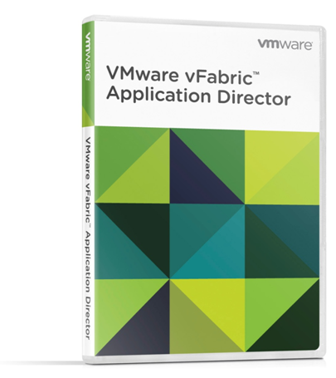
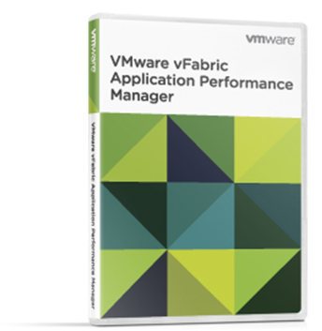
Goals for our Products
Enable the Cloud Operating Model
Model once, Deploy anywhere
Let the cloud richness shine through
Enable the DevOps model
Enable collaborative model
Provide agility with efficiency
Enable “any” app
Open & Flexible & Extensible
Enable application lifecycle
Enable apps in their journey to PAAS
Notes:
With this analysis, we formed 3 core goals for our product offerings :
Enable the cloud operating model. Separate the application definition from deployment environment bindings. Allow Dynamic Bindings to variety of Cloud , thereby providing hybrid cloud support.
When you support hybrid cloud, the next question to answer is, how to support difference in features of each cloud. Whether we want to set a common denominator or leverage the advanced features of some cloud
The second core goal is : Provide features that work with devOps model. And for companies that have these functions separate, provide a platform that enables collaboration between developers and operation teams. Provide agility of deployment and updates with some level of standardization and governance for large enterprises.
And third goal : stay true to the promise of any app any where.
If we get this right, we have got you started on your journey to PAAS that Shahar described

Slide 21


A Model Driven Approach to Application Provisioning
Catalog of
Application
Services
Application Blueprint
Deployment
Profiles
Deployments
Dev
Web Server
App
OS
Application Server
App
Test
App
OS
OS
OS
Messaging
In-memory database
OS
Prod
Notes:
Based on these goals, as we started building our Application Provisioning product, we said, why not provide a canvas for developer where they can define their code dependencies , code configurations and the underlying appstack that the code will run on. We call it Application Blueprint. Application Blueprint enables architects and developers to capture in ONE document, all the application knowledge essential for successful deployments. It is a live document as the application goes through continuous build and integration process. I am going to show you these .. In demo
Application Blueprint may leverage reusable services that are defined in a Catalog.
As the developer plans to deploy his app, he defines a Deployment Profile to bind the app to a specific deployment environment and deploy it, thus enabling late binding of the app to the infrastructure/IaaS platform.
When the app is handed over to QE, they would define their OWN deployment profile to bind the app to their environment. Finally the Production team binds and deploys the app to Production environment.
Since the app blueprint is defined once and contains all knowledge about dependencies and app configurations, the time it takes to move the app from dev to test to production is significantly reduced.
Lets see division of responsibilities to make this approach work in large enterprises setup with traditional roles as they are not going to change overnight..

Slide 22
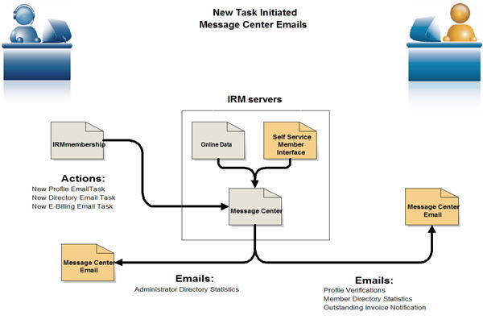


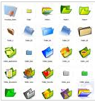


Collaborative Platform for various roles
Application Blueprint
Logical Application Topology with Application Policies, Configurations
Pre-instrumented with App Monitoring
Application Binaries
Application Stack - (Middleware, OS)
Architect
Deployment
Profile
(dev)
Deployment
Profile
(test)
Deployment
Profile
(prod)
Collection of deployment settings
Makes blueprints portable across clouds
App Dev, QA, Release
Standardized configurations of OS, Middleware
Catalog
Deployment Environments
EC2
Public
vCloud
Private
vCloud
Cloud Admin
Middleware Admin
Notes:
First we have cloud admin that sets up various Deployment Environments. These could be an ORGVDC on private vCloud or a public vCloud or it could be Amazon account that would be charged as capacity is used from a particular availability zone. . I am going to show you these .. In demo
Catalog Admin to setup a set of common services that form the application stack, thereby enabling standardization of middleware components . Goes to the point of agility with control
Architect defines the app blueprint as we saw earlier
Finally dev/test/release teams deploy the app into their own environment.

Slide 23
Ongoing Updates : Model driven App Management
Change
Change
Deployment
Application Blueprint
Change
Application Binaries
Change
Deployment
Promote Update to Production
Application Stack - (Middleware, OS)
Change
Make a change – code, config, scale-out
Update
Profile
Analyze impact & auto-generate flow with dependencies
Notes:
At this point the application has been deployed. Lets look ongoing maintenance aspect.
Lets say db port change occurs. Since the application blueprint has the entire topology and configuration dependencies, we could automatically calculate the impact on dependent components if any change is done. In this case, db port results into change in jdbc url for the war. We capture the analysis in Update Profile that could be applied on not only this deployment but all deployments created through this BP.

Slide 24
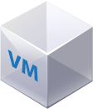
Performance Monitoring
Application Health
Avg Hits/Minute,
Avg Latency, Errors
Network Transactions
Avg Network
Latency
  Automatically traces transactions
  Measures transaction times – Latency, Usage, and Throughput
Thread Pool, JDBC
Pool, Number of JVM
Queue Size,
Enqueue Count
OS
Application Infrastructure
  Monitors infrastructure/middleware
  Collects thousands of metrics across all tiers – web, app, messaging, DB.
App
App
OS
OS
OS
Servlets, beans
Code latency
Code
  Instruments the application code to easily detect “bad code” that impacts application performance
OS
Notes:
Performance monitoring is another area where we spent a lot of time. We understand app topology and its configurations. Wouldn’t it be great if we could show the entire network path that is traversed when a request such us makePayment through Google Wallet is made. Doing so gives much richer context to KPIs like throughput, network latency.
Next is knowing the health of AppStack components – is the appserver healthy , is message bus overloaded?
Finally, we added technologies like byte-code instrumentation that helps users zoom into code level details for troubleshooting
Our App monitoring product thus takes into account breadth and depth of technologies to help with performance monitoring, troubleshooting, change correlation to take actions like scale out , rollback ,so forth.

Slide 25
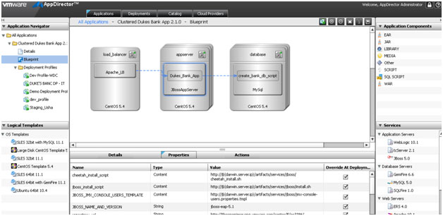
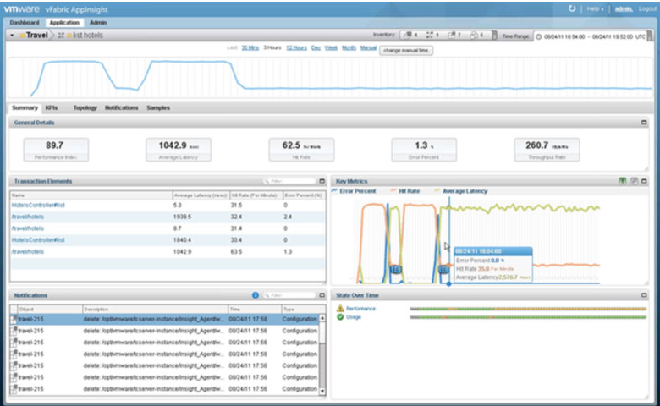
IT Transformation – Through Continuous Application Management
Realizing IT Transformation through vFabric Application Management Suite
VMware vFabric
Application Director
An application operations solution designed specifically to help application teams to accelerate and automate the deployment and updates of applications across the cloud
VMware vFabric Application
Performance Manager
An application performance management solution to provide application owners with the real-time visibility and control they need to manage their SLAs in the cloud
Notes:
All the concepts we saw so far are now included in the 2 products we launched early this year –
vFabric Application Director – that accelerates application deployment of Apps in Hybrid Cloud Environments and further enables ongoing operations on these deployments.
vFabric Application Performance Manager – that enables real time visibility into App performance, provides deep troubleshooting and change correlation for apps running in hybrid cloud.

Slide 26
Demo

Slide 27
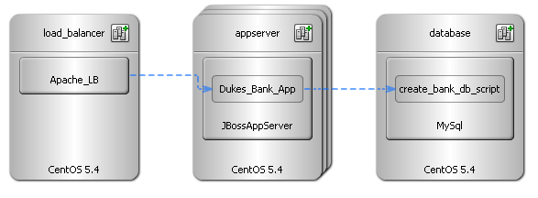
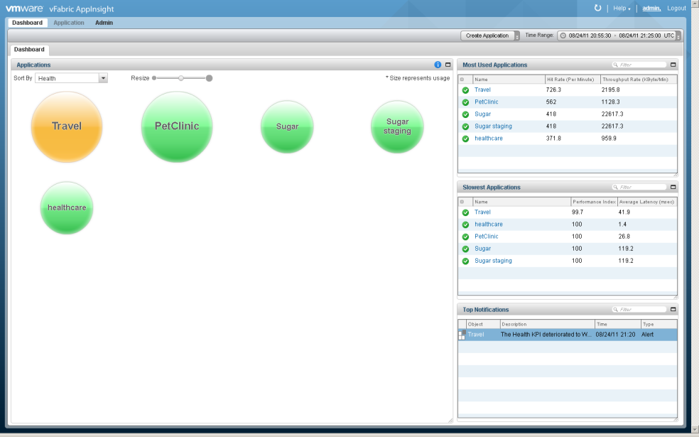
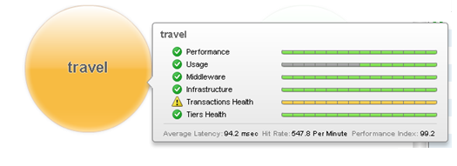
Summarizing : Integrated Active Application Management
Overview
  Cloud agnostic Application Blueprints that can deploy to ANY Cloud
  Application Monitoring Dashboard that provides in-depth application visibility and correlates app changes to its performance
  Automatic Impact Analysis to perform EFFECTIVE Updates on the app reducing the app downtime.

Slide 28






Or Need More Information
vFabric Application Management Resources
Have Questions for Presenters?
http://www.vmware.com/products/
Komal Mangtani
kmangtan@vmware.com
@komalmangtani
Contact Us
Shahar Erez
vfabricappmgmt@vmware.com
serez@vmware.com
@vFabricAppMgmt
@shaharer
Application Director
http://www.vmware.com/go/try-vfabric-app-director
Application Performance Manager
http://www.vmware.com/go/try-vfabric-apm

